Slide 1
Vehicle Number Plate Recognition
using MATLAB

Slide 2
Introduction
With the increase in number of accidents and traffic rule violations , identification has become a task of prime importance.
This task become more complicated since the captured number plate can be from different environment background having different fonts ,angles , sizes etc.

Slide 3
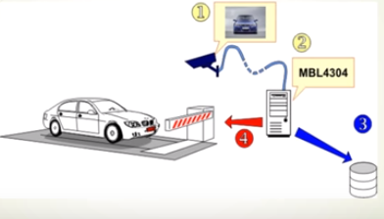
Basic Idea

Slide 4
Motivation
Application in authentication of car for security purposes , enforcement of traffic rules ,
toll collection , recovery of stolen cars
Different weather conditions , orientations and speed at which vehicle was moving when the image
was captured pose more challenges to this problem.

Slide 5
Number Plate Recognition
System
Stages in Number Plate Recognition:
Pre Processing
2.Extraction of characters.
3.Recognition using template matching.

Slide 6
Project Goals
Image enhancement to improve the accuracy of recognition system.
Extraction of character into separate images.
Recognition of each character.

Slide 7
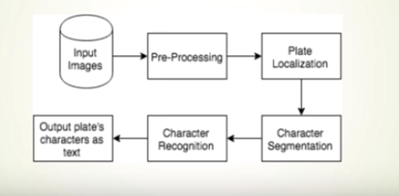
System Design

Slide 8
Intermediate steps involved
Pre-processing:
1.RGB to Gray
2.Morphological processing
3.Convolution
4.Thinning of Image

Slide 9
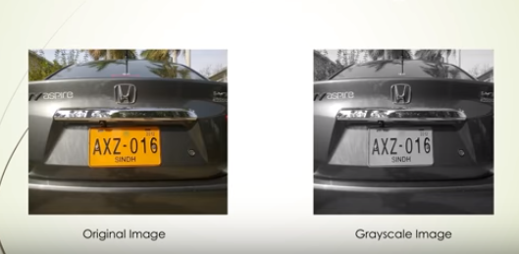
Pre-processing

Slide 10
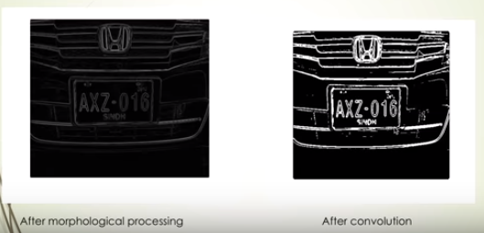
Pre-processing

Slide 11
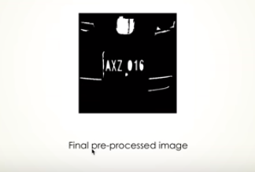
Pre-processing

Slide 12

Character Extraction

Slide 13
Character Recognition
Finally the character will be recognized as: AXZ016
These are the three stages to obtain the vehicle number plate in automation way where the number will be saved in database,

Slide 14
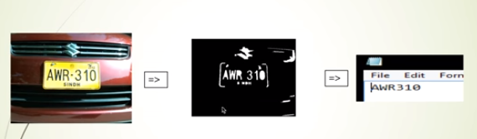
Obtained Result
If we consider the whole process then the entire system will provide us following output:

Slide 15
Limitations
We have worked on still image which is not moveable.
To obtain correct output we need high resolution image. In that case if the weather is gloomy , it is not possible to capture clear images.
Multiple matches have been avoided like (S and 5,Z and 8).

Slide 16
Conclusion & Future Plan
The vehicle plate number can be used to retrieve more information about the vehicle and its owner, which can be used for further processing.
This way, a real-time system can be developed for automating the process of toll collection, traffic management, law enforcement, vehicle parking, etc.
In future we want to apply this entire system for moving vehicle to capture plate number .
Further we will work on HSV image that will provide us more accurate output.

Slide 17
Thank You!

